Slide 1
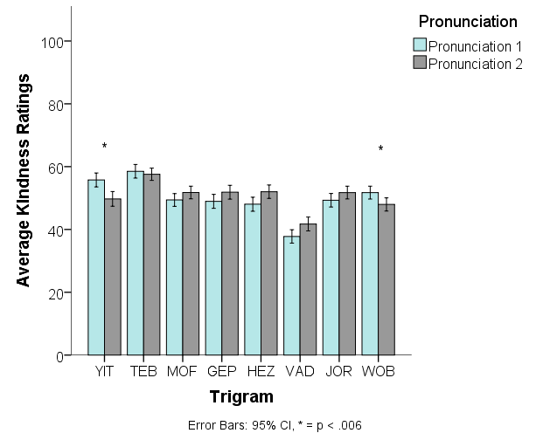
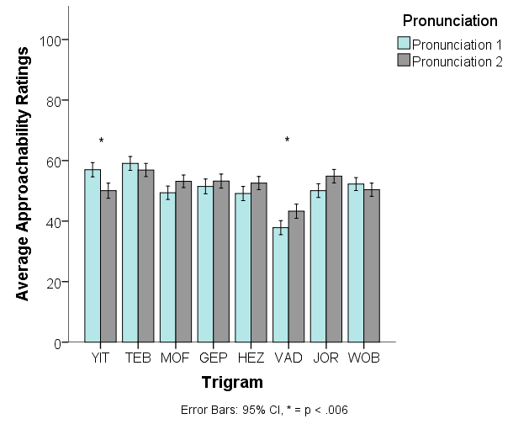
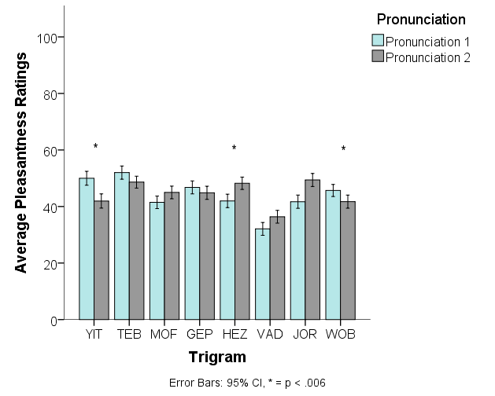
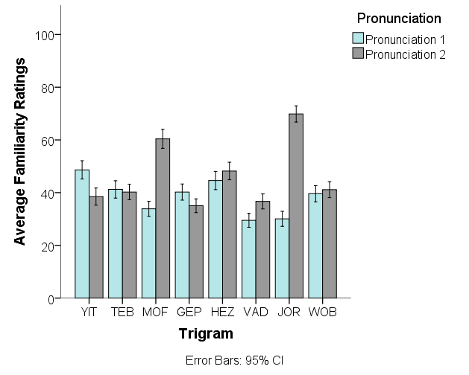
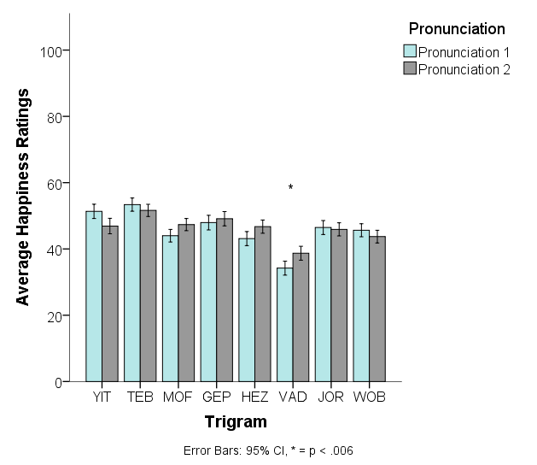
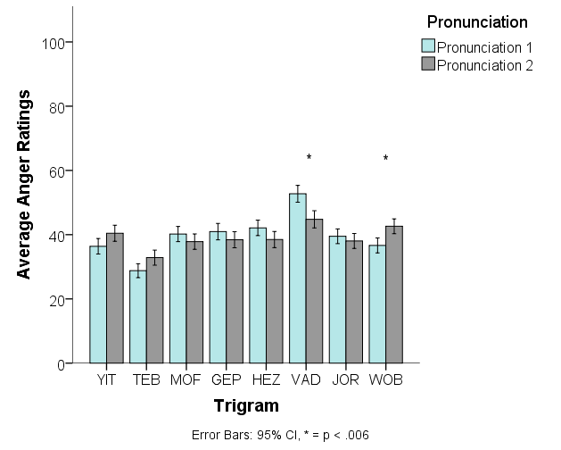
Phonetic Preferences for CVC Trigrams
Jahnavi R. Delmonico and Erin M. Buchanan
Missouri State University
The Question
How do we decide whether we like the sound of something? Do we prefer certain sounds outright? Languages are sometimes said to have emotional profiles; i.e. German sounds angry while French sounds romantic. Supposedly, “cellar door” is , independent of meaning, the most beautiful phrase in the English language. These folk-psychological examples imply that some sounds are preferable by their very nature. We set out, in this experiment, to explore the existence of phonetic preferences in nonsense words.
Contact: Jahnavi Delmonico (jahnavi323@live.missouristate.edu) or Erin Buchanan (erinbuchanan@missouristate.edu)
Method
We created eight pairs of consonant-vowel-consonant (CVC) trigrams with the following criteria:
Readily pronounceable
Matched for low/medium associative value (Archer 1960)
Differing by one phoneme only
Pronunciations:
yɨt/yit
mof/mɐf
hez/xez
tib/tɜb
Pronunciations were recorded and presented in randomized order in a Qualtrics survey. All participants listened to both pronunciations, separated by a distractor word-find task. After each recording, participants were asked for ratings of:
Familiarity of trigram
Pleasantness of trigram
Happiness of speaker
wob/wɒb
gep/dʒep
væd/vɒd
joɹ/joɾ
Anger of speaker
Approachability of speaker
Kindness of speaker
Hypothesis
This research was purely exploratory; we were looking for any differences in ratings across phonemes.
Results
314 participants:
Missouri State University students
166 Males
143 Females
Analysis:
Five separate repeated-measures ANCOVAs for each of the 8 trigrams (40 total)
Perceived familiarity difference scores entered as covariate
Familywise Bonferroni correction = .00625
85.7% White
M = 19.36, SD = 2.26, Mdn = 19, Range = 18 – 41
ESL students excluded from analysis
Discussion
We found five significant main effects of pronunciation that were not qualified by any interaction; participants rated the speaker of the trigram VAD as sounding angrier when using an “ahh” sound, and the same for the trigram WOB. Speakers of the WOB trigram were also rated as sounding less kind when using the “ahh” pronunciation. Participants rated speakers of the trigram YIT as sounding more approachable with an “ee” sound, and speakers of the trigram WOB as sounding more approachable with an “oh” sound.
Five significant main effects emerged that were qualified by interactions with familiarity scores, with higher familiarity scores associated with higher ratings of speaker happiness, speaker kindness, speaker approachability, and trigram pleasantness. Fourteen additional interaction effects were found to demonstrate this pattern—an apparent confirmation of the mere exposure effect.
Effect sizes were generally small, ranging from η_{p}² = .027 to η_{p}² = .205, M = .057, SD = .039, Mdn = .043. Effect sizes and graphs of interactions are not included for reasons of space.

